Slide 1
CORPORATE STRATEGY
Module-I

Slide 2
CORPORATE STRATEGY
MBA205
Meaning of strategy and strategic management,
Stages of strategic management, the strategic management model,
benefits of strategic management,
key terms in strategic management,
Competitive advantage, strategists, vision, mission, long term objectives, strategies,
annual objectives and policies.

Slide 3
Strategic Management
Art & science of formulating, implementing, and evaluating, cross-functional decisions that enable an organization to achieve its objectives.

Slide 4
STRATEGY
Strategy refers to the determination of the purpose and basic long term objectives of an enterprise
Involves adoption of different courses of action, with proper allocation of resources.
Strategy is a means to achieve an organization's missions and objectives.
Commitment of Resources to realize orgl GOALS and OBJECTIVES

Slide 5
Strategist
a person skilled in planning action or policy, especially in war or politics.
"he is a cunning military strategist“

Slide 6
Sun Tzu’s Military Strategy and Management
“An army shouldn’t go to war, unless it is certain that it has an advantage over the enemy.”
Lesson: Management should not only know their own internal capability but also the resources and competences of their competitors.
“A territory must be conquered as quickly as possible, and unnecessary blood shed should be avoided.”
Lesson: Management should avoid unnecessary waste of time and resources.’

Slide 7
STRATEGY
Strategy is about positioning an organization for Sustainable Competitive Advantage -SCA.

Slide 8
STRATEGY
It involves making choices about which industries to participate in, what products and services to offer, and how to allocate corporate resources to achieve a sustainable competitive advantage.
Men/women HR
Machinery PR
Material PR/MM
Money FIN

Slide 9
Attitude
Skill
Knowledge
ASK

Slide 10
STRATEGY
And its primary goal is to create value for shareholders and other stakeholders by providing customer value (de Kluyver, 2000).

Slide 11
Strategic management is
  To achieving the organization’s purpose and materializing our vision through the use of strategies
    Emphasis and direction
    Optimum use of resources
    Development

Slide 12
Strategy:
Consists of the combination of competitive moves and business approaches used by managers to run the company
Management’s “game plan” to -
Attract and please customers
Stake out a market position
Compete successfully
Grow the business
Achieve targeted objectives

Slide 13
Strategy
Strategies are just complex decisions for telling the importance things to be done and for guiding actions.
Strategies have to base on purpose, wish and reality.
  Mission is our ultimate purpose
  Vision is our ultimate wish
  Our environment and situation are the current reality

Slide 14
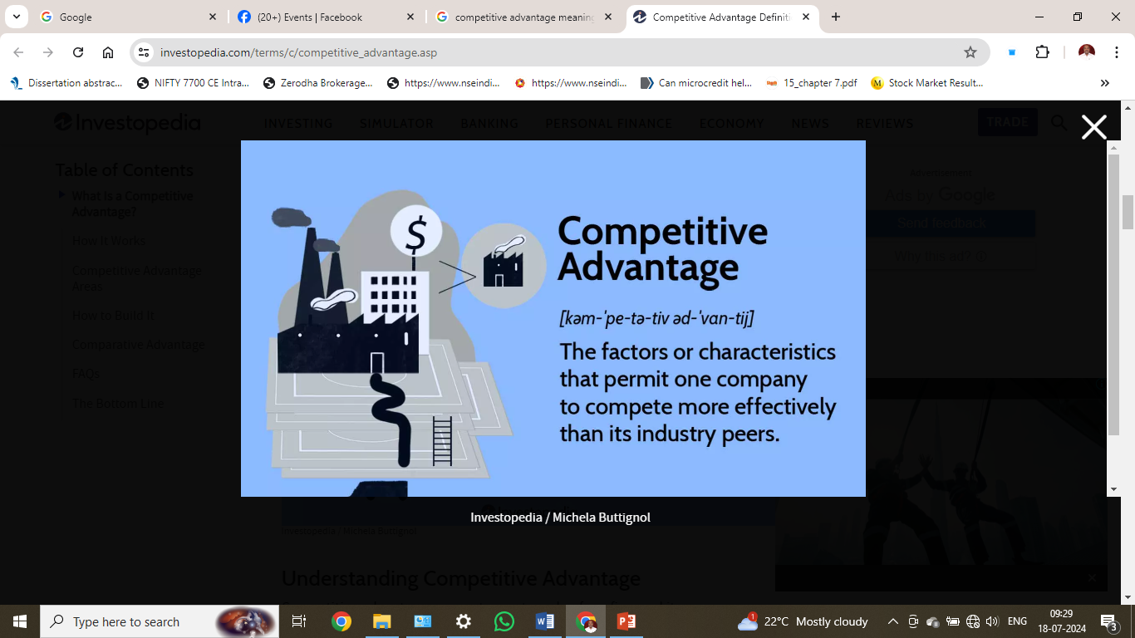

Slide 15
We set strategies to fulfill our mission and to progressively realize our vision.
Organisation also set strategies to alter our reality.
Strategies have to be implemented effectively to be meaningful. This means strategies must be realizable.

Slide 16
Definition of Strategy
“Strategy is the direction and scope of an organisation over the long term: which achieves advantage in a changing environment through its configuration of resources and competences with the aim of fulfilling stakeholder expectations.” (Johnson and Scholes, 2005:9).

Slide 17
What is Strategic Management?
“Strategic Management can be defined as the art and science of Analysing, formulating, implementing, and evaluating cross-functional decisions that enable an organisation to achieve its objectives”
David Fred (2003: 5)

Slide 18
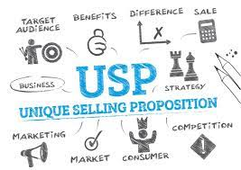

Slide 19
“Strategic Management is a process of formulating, implementing, and evaluating cross-functional decisions that enable the organisation to define and achieve its mission, and ultimately to create value” Stephen Porth (2003: 2).

Slide 20
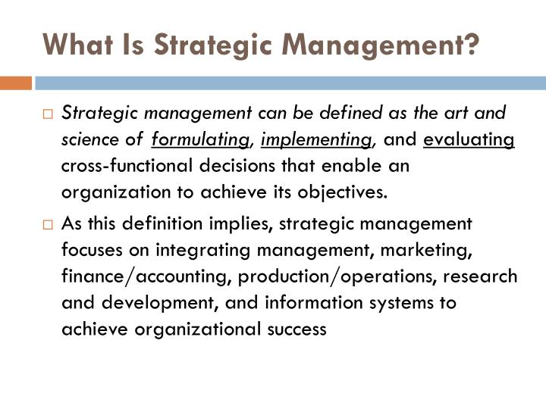


Slide 21
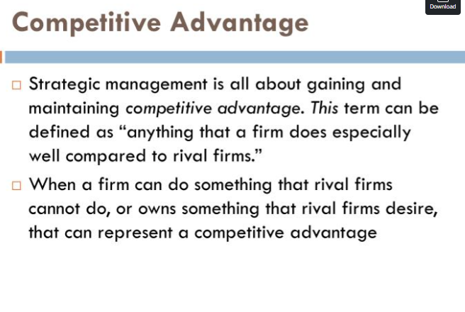

Slide 22
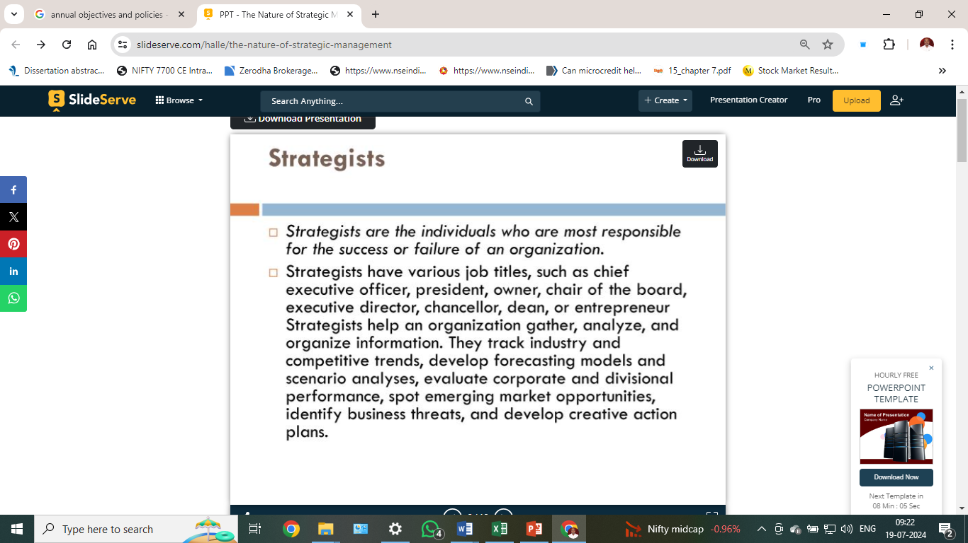

Slide 23
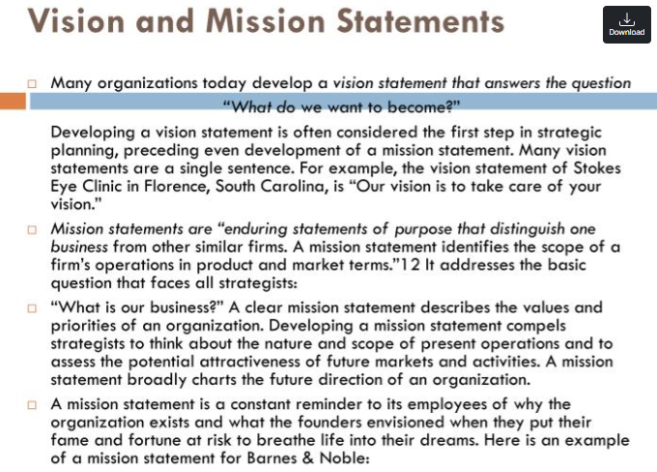

Slide 24
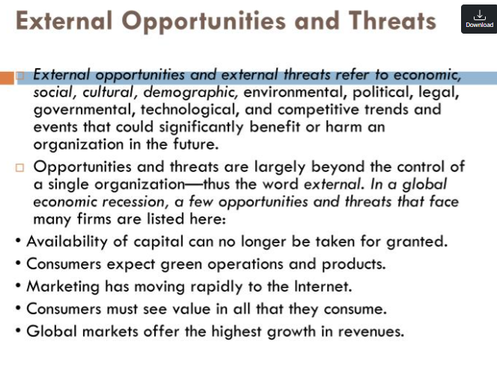

Slide 25


Slide 26
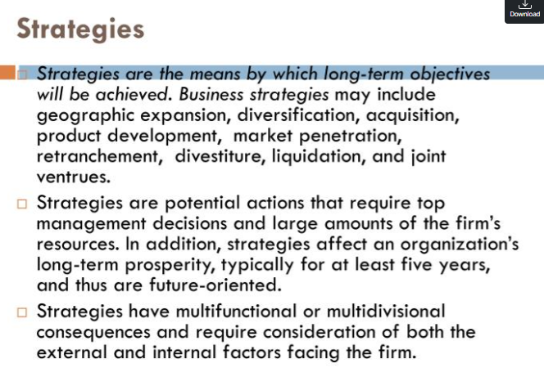

Slide 27
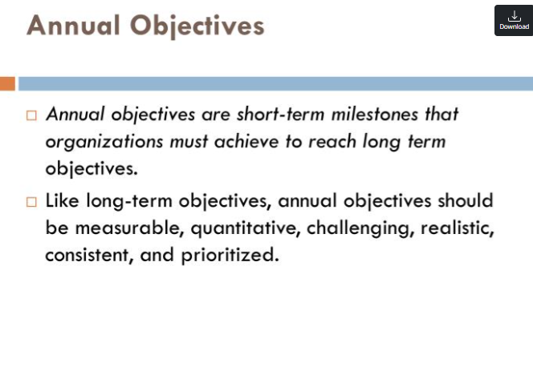

Slide 28
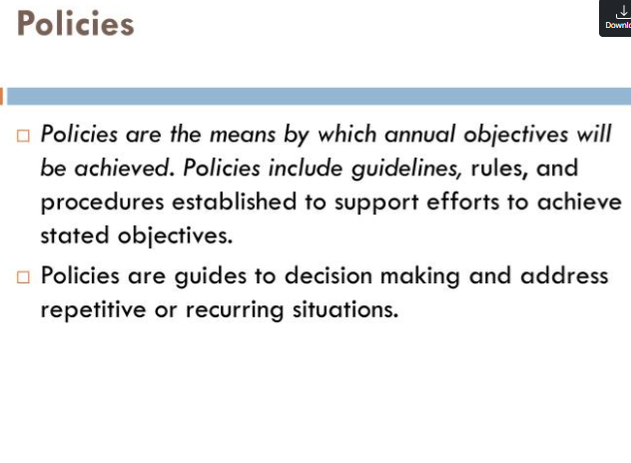

Slide 29


Slide 30
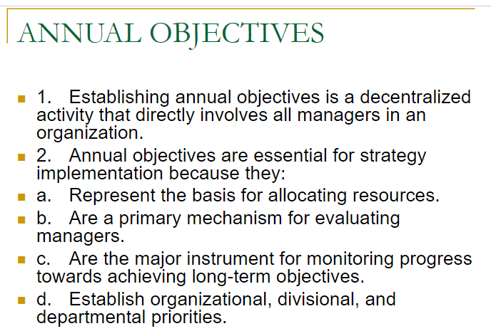

Slide 31
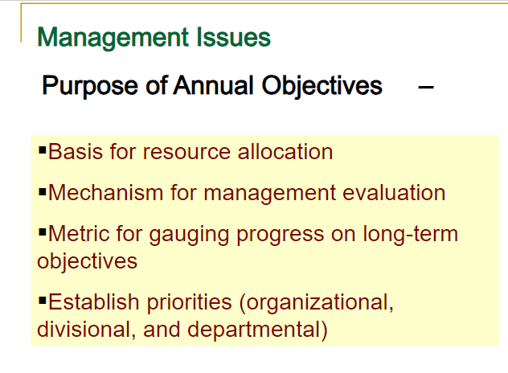

Slide 32
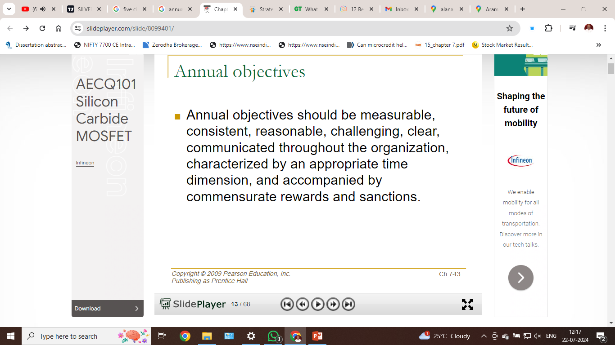

Slide 33
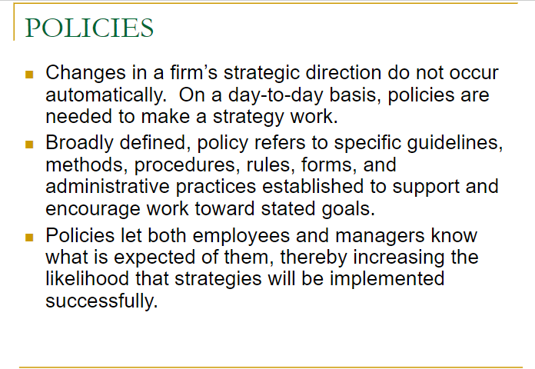

Slide 34
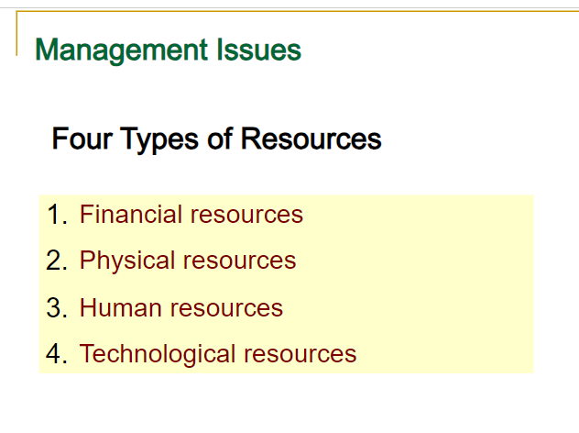

Slide 35
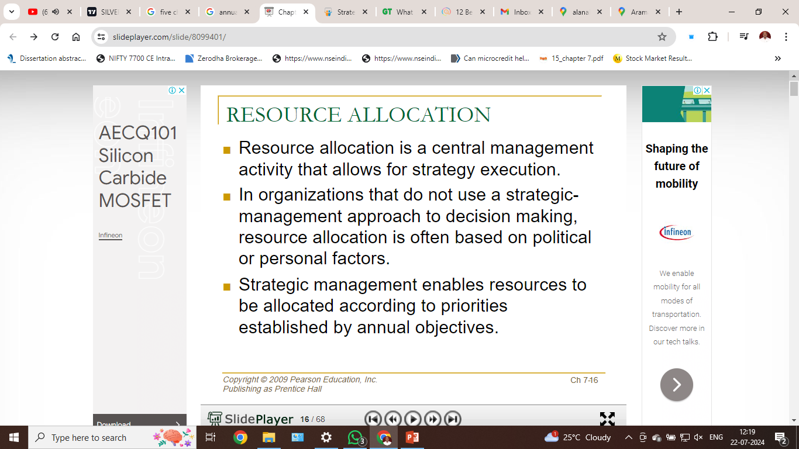

Slide 36
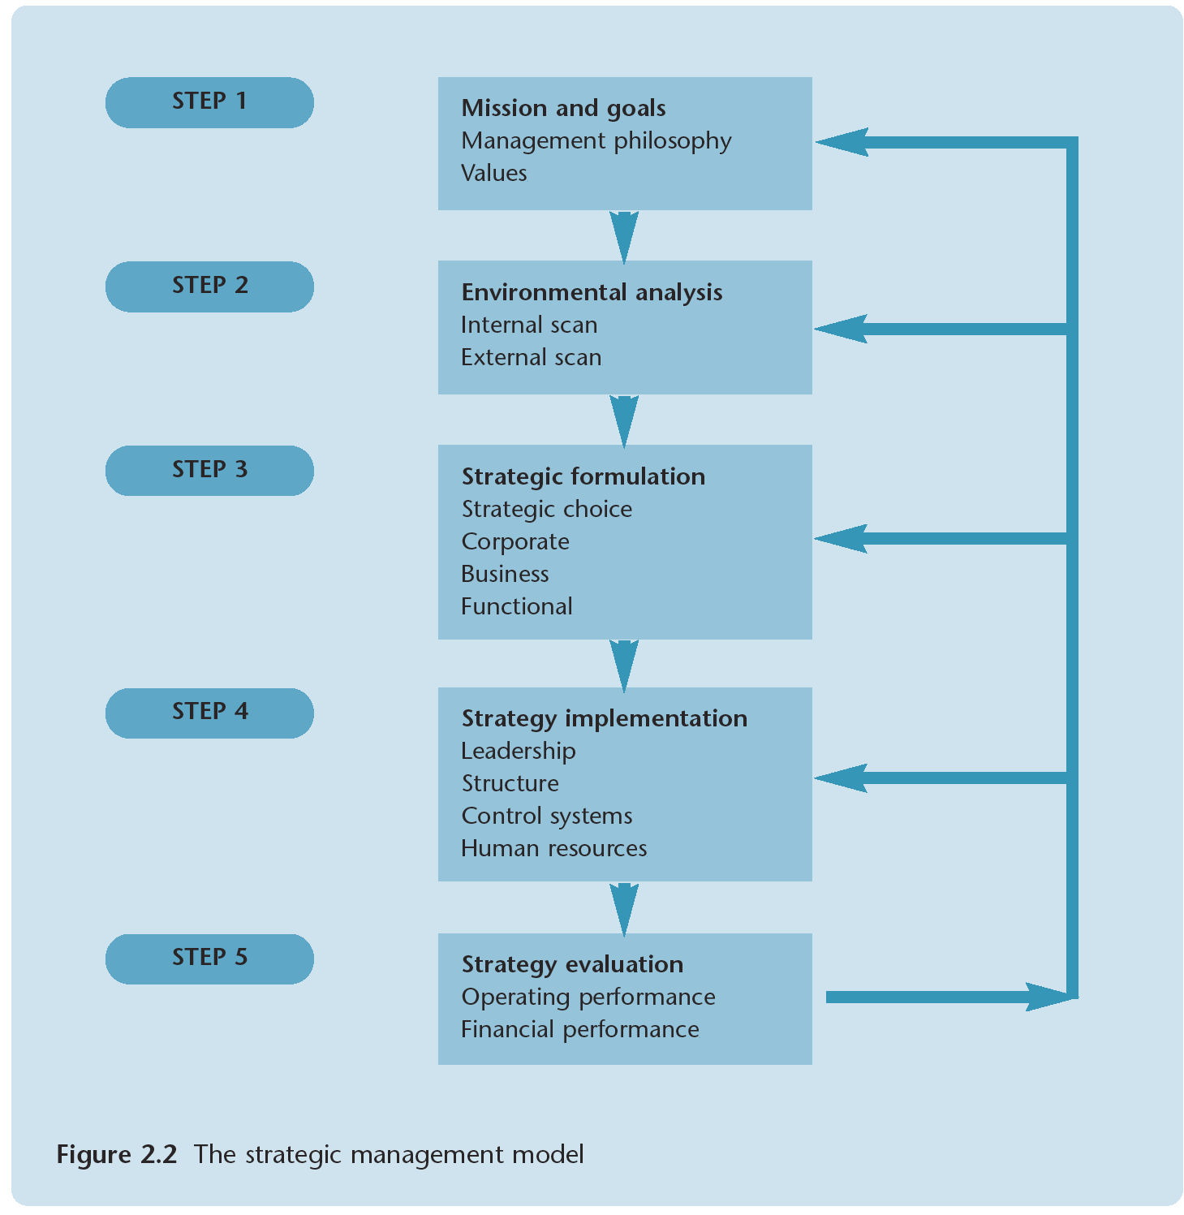

Slide 37
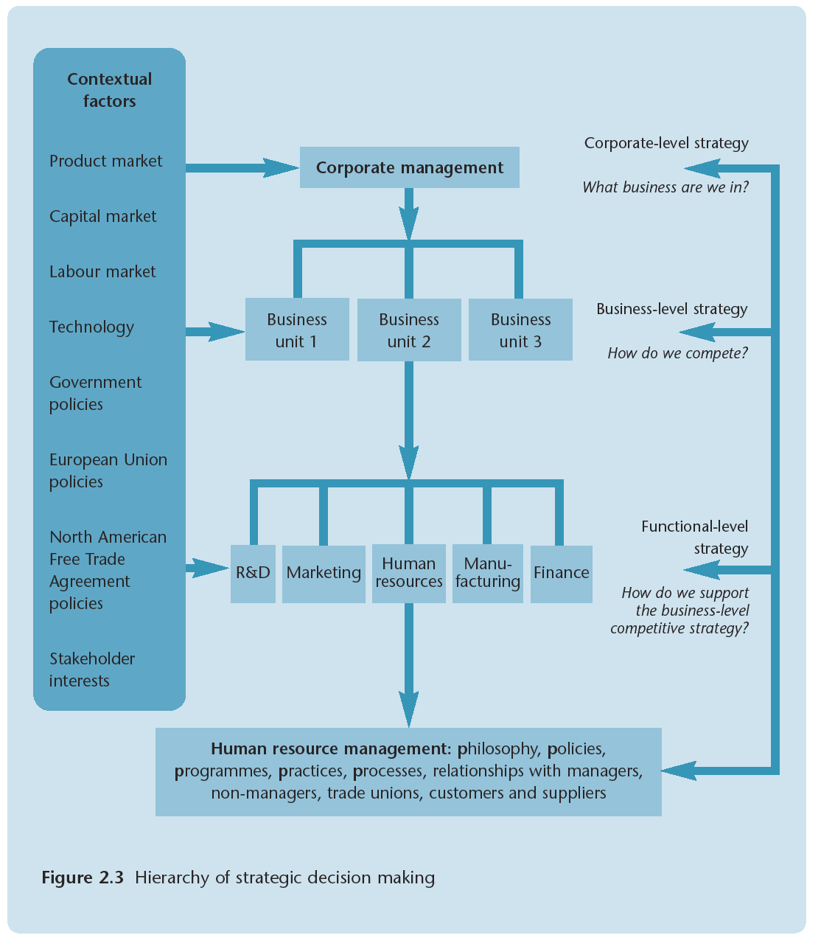

Slide 38
Policy
Policies are general statements that guide managers' thought process in decision making.
In simple terms, policies act as guidelines; enabling organizations to achieve their goals

Slide 39
Nature and Purpose of Strategies and Policies
Direction
Framework for plans
Need for operational planning
All perspective

Slide 40
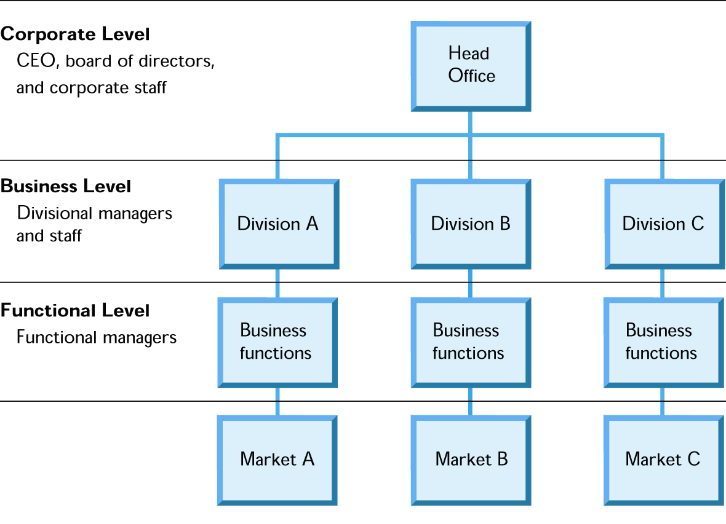
Strategic Managers for All Levels

Slide 41
Corporate level strategy
Formulated at the top-level, corporate.
Ideal for those organizations having more than one business unit.
Two approaches in the formulation of strategy are
Value-based approach: Value-based approach takes into account the individual's beliefs and helps to do business ethically.
Corporate portfolio approach: The top management evaluates business units on the basis of marketplace and organizational strategy

Slide 42
Business level strategy
Business strategy focuses on a firm's competitiveness in the marketplace.
Developed by the heads of respective departments, and approved by the top management;
These strategies are designed in response to the changing environment and competitive conditions.

Slide 43
Functional level strategy
Functional strategies are designed to emphasize functional competencies so that firms can gain the competitive advantage.
These strategies are designed and developed by the functional heads, and are approved by the top management.

Slide 44
Functional level Strategy
Principally involve action oriented operational issues.
Relatively short range and involve less risk.
Requires company wide cooperation.
Relatively concrete & quantifiable
They receive critical attention
Brand name labeling, R&D, inventory level

Slide 45
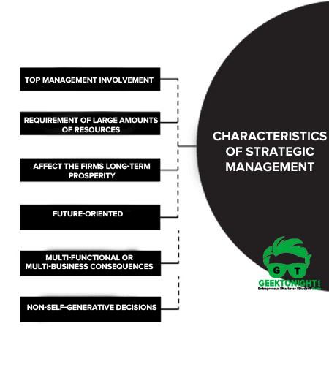

Slide 46
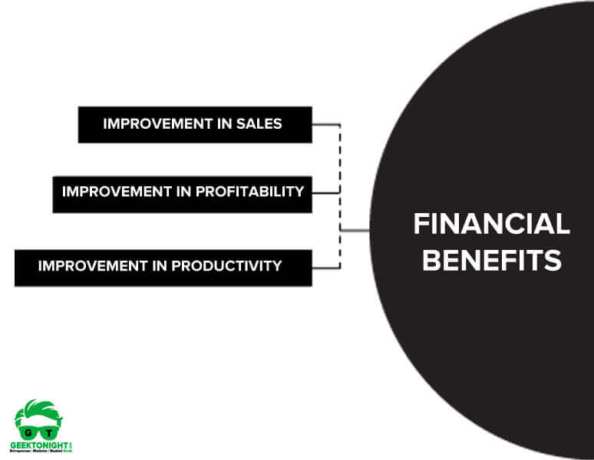
Benefits of Strategic Management

Slide 47
Benefits of Strategic Management
1. Financial Benefits: Research indicates that organisations that engage in strategic management are more profitable and successful than those that do not.
Businesses that followed strategic management concepts have shown significant improvements in sales, profitability and productivity compared to firms without systematic planning activities.

Slide 48
Benefits of Strategic Management
Improvement in sales
Improvement in profitability
Improvement in productivity

Slide 49
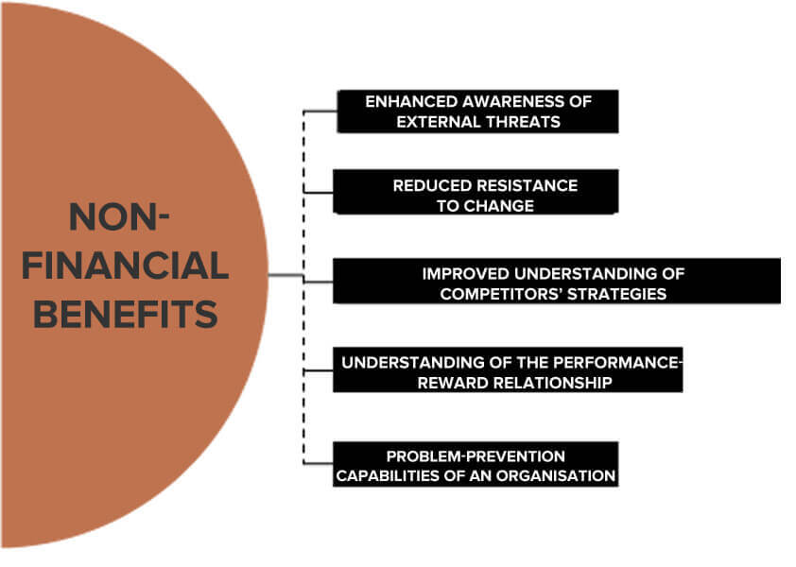

Slide 50
Benefits of Strategic Management
Enhanced awareness of external threats
Improved understanding of competitors’ strategies
Reduced resistance to change
A clearer understanding of the performance-reward relationship
Enhanced problem-prevention capabilities of an organisation
Increased interaction among managers at all divisional and functional levels
Increased order and discipline

Slide 51
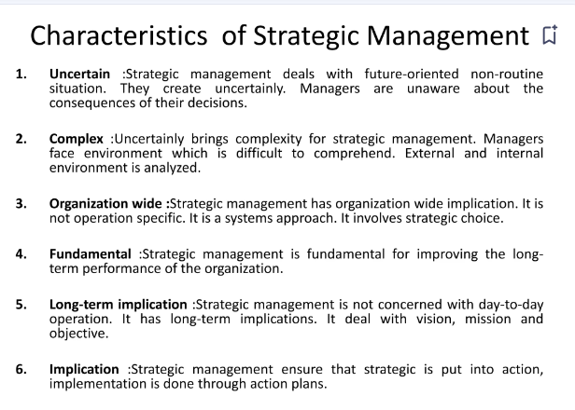

Slide 52
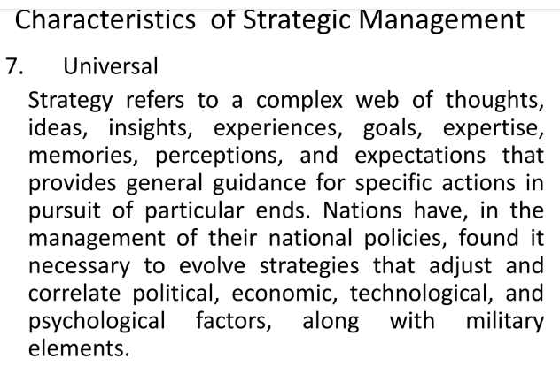

Slide 53
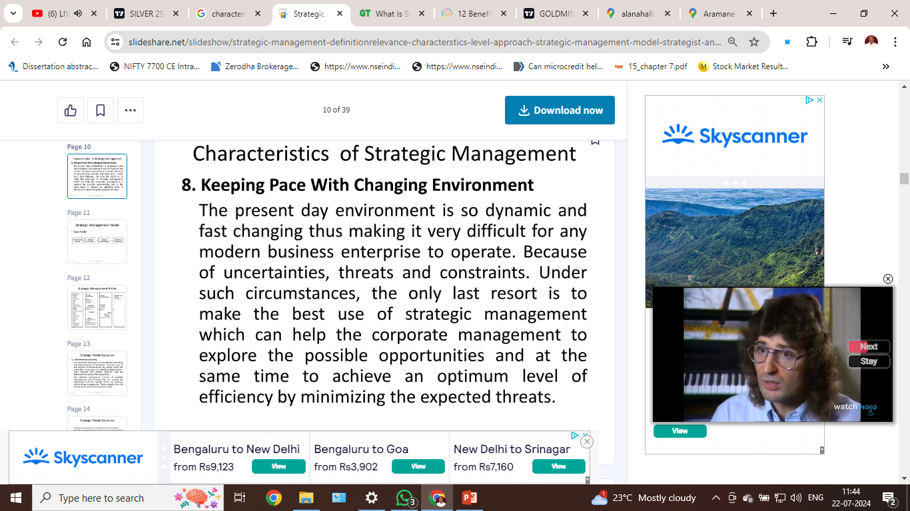

Slide 54
Characteristics of
Strategic Management
Characteristic | Levels of strategy
 | Corporate | Business | Functional
Type | Conceptual | Mixed | Operational
Measurability | Value judgments dominants | Semi quantifiable | Usually quantifiable
Frequency | Periodic or sporadic (irregular) | Periodic or sporadic-(irregular) | Periodic
Profit potential | Large | Medium | Small

Slide 55
Characteristic | Levels of strategy
 | Corporate | Business | Functional
Cost | Major | Medium | Modest
Time horizon | Long range | Medium range | Short range
Flexibility | High | Medium | Low
Cooperation | Considerable | Moderate | little
Adaptability | Low | Medium | High
Relation to present activities | Innovative | Mixed | Supplementary
Risk | Wide range | Moderate | Low

Slide 56
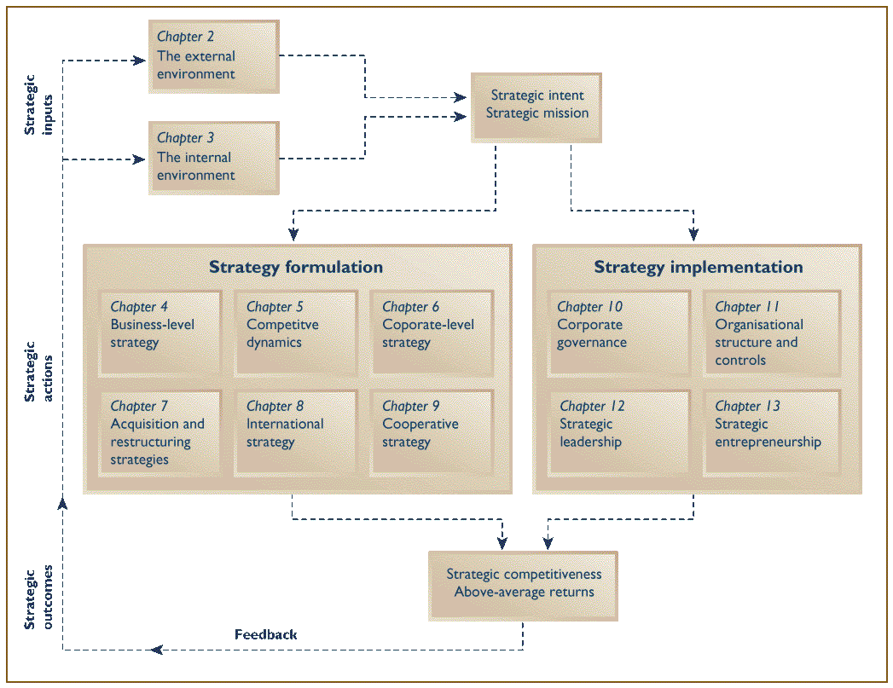
The strategy Development and management process

Slide 57
The Strategic Management Process:
Strategic Management
  Provides the theme and focus of the future direction for the firm.
    Responding to changes in the external environment—environmental scanning
    Allocating scarce resources of the firm to improve its competitive position—internal responses to new action programs
  Requires strong links among mission, goals, objectives, strategy, and implementation.

Slide 58
The Strategic Management Process
Is the process of assessing ‘what we are’ and deciding and implementing ‘What we intend to be and how we are going to get there’
Strategy describes how an organization intends to compete with the resources available in the existing and perceived future environment

Slide 59
Strategic Management Process
Step 1: Identifying the organisation’s current mission, objectives, and strategies
  Mission: the firm’s reason for being
    Who we are,
    What we do, and
    Where we are now
  Goals: the foundation for further planning
    Measurable performance targets
Step 2: Conducting an external analysis
  The environmental scanning of specific and general environments
  Focuses on identifying opportunities and threats

Slide 60
Strategic Management Process (cont’d)
Step 3: Conducting an internal analysis
  Assessing organisational resources, capabilities, activities and culture:
    Strengths (core competencies) create value for the customer and strengthen the competitive position of the firm.
    Weaknesses (things done poorly or not at all) can place the firm at a competitive disadvantage.
Steps 2 and 3 combined are called a SWOT analysis (Strengths, Weaknesses, Opportunities, and Threats)

Slide 61
Strategic Management Process (cont’d)
Step 4: Formulating strategies
  Develop and evaluate strategic alternatives
  Select appropriate strategies for all levels in the organisation that provide relative advantage over competitors
  Match organisational strengths to environmental opportunities
  Correct weaknesses and guard against threats

Slide 62
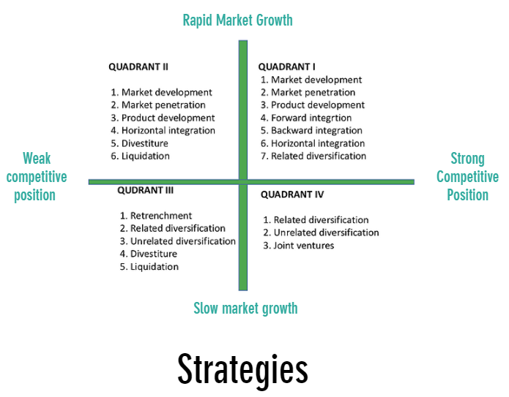

Slide 63
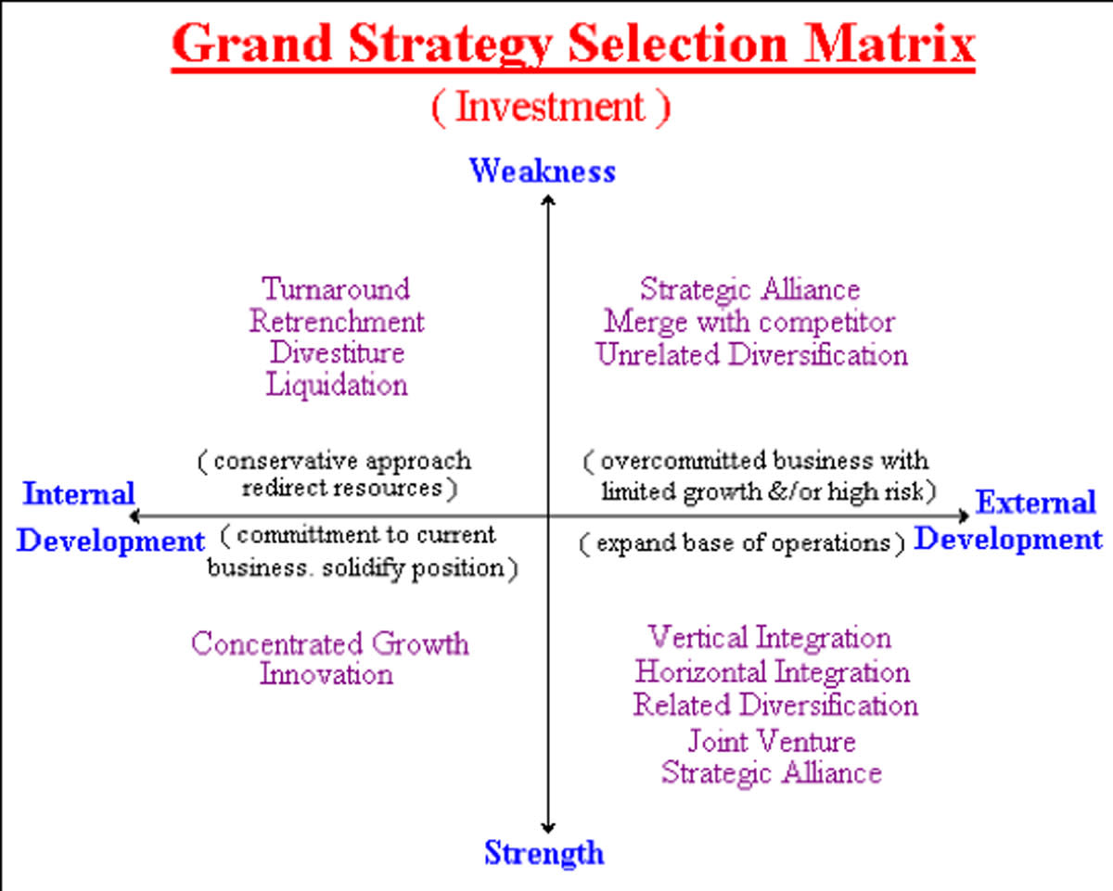

Slide 64
Strategic Management Process (cont’d)
Step 5: Implementing strategies
  Implementation: effectively fitting organisational structure and activities to the environment
  Effective strategy implementation requires an organisational structure matched to its requirements.
Step 6: Evaluating results
  How effective have strategies been?
  What adjustments, if any, are necessary?

Slide 65
Six Steps of The Strategic Control Process
Determine what to control.
Set standards.
Measure performance.
Compare performance.
Analyze deviations.
Decide if corrective action is needed.

Slide 66
Strategic Management Process
Step 1 – Review or develop Vision & Mission
Step 2 – Business and operation analysis (SWOT Analysis)
Step 3 – Develop and Select Strategic Options
Step 4 – Establish Strategic Objectives
Step 5 – Strategy Execution Plan
Step 6 – Establish Resource Allocation
Step 7 – Execution Review

Slide 67
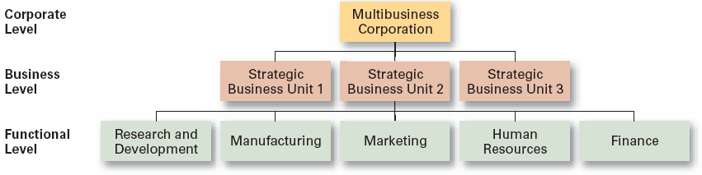
Levels of strategy

Slide 68
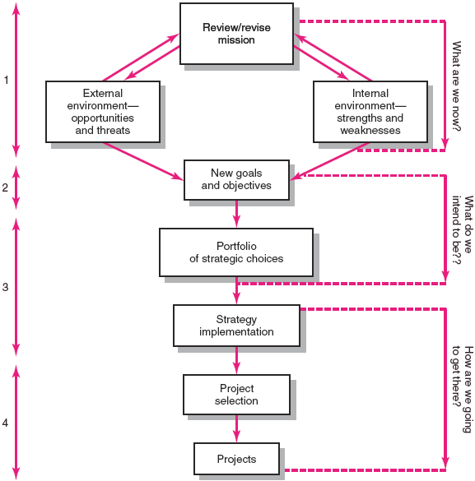
Strategic Management Process

Slide 69
Strategic Management Process (cont’d)
Four of Activities of the Strategic Management Process
  Review and define the organizational mission.
  Set long-range goals and objectives.
  Analyze and formulate strategies to reach objectives.
  Implement strategies through projects

Slide 70
Strategic management is defined as the set of decisions and actions that results in the formulation and implementation of plans designed to achieve a company’s objectives.
It comprises of nine critical tasks:
Formulate the company’s mission, including broad statements about its purpose, philosophy and goals

Slide 71
Conduct an analysis that reflects the company’s internal conditions and capabilities
Assess the company’s external environment, including both the competitive and the general contextual factors

Slide 72
Thinking Strategically
The Three Big Strategic Questions
1.Where are we now?
2. Where do we want to go?
Business(es) to be in and market positions to stake out Buyer needs and groups to serve Outcomes to achieve
3. How will we get there?
A company’s answer to “how will we get there?” is its strategy

Slide 73
The Purpose of Strategy
The essence of strategy is coping with competition. The corporate strategist’s goal is to find a position in the market where his or her company can best defend itself against the collective industry forces or can influence them in its favor.
It provides direction
It provides coherence
It allows day-to-day processes to be designed

Slide 74
Analyze the company’s options by matching its resources with the external environment
Identify the most desirable options by evaluating each option in light of the company’s mission
Select a set of long-term objectives and grand strategies that will achieve the most desirable options

Slide 75
Develop annual objectives and short-term strategies that are compatible with the selected set of long-term objectives and grand strategies
Implement the strategic choices by means of budgeted resource allocations in which the matching of tasks, people, structures, technologies and reward system is emphasized
Evaluate the success of the strategic process as an input for future decision making.

Slide 76
Organizational Strategy
Organizational Strategy is the way in which an organization uses its knowledge and other resources to achieve its economic purpose.

Slide 77
The Nature of Strategy
• Defined
• Planned
• Proactive
• With detail
• Vague
• Loose
• Reactive

Slide 78
Why Is Strategy Important?
A compelling need exists for managers to proactively shape how a firm’s business will be conducted
A strategy-focused firm is more likely to be a strong bottom-line performer than one that views strategy as secondary

Slide 79
A Business Model
A business model addresses “How do we make money in this business?”
Is the strategy capable of delivering good bottom-line results?
Do the revenue-cost-profit economics of the strategy make good business sense?
Look at revenue streams the strategy is expected to produce
Look at associated cost structure and potential profit margins
Do resulting earnings streams and ROI indicate the strategy makes sense and the company has a viable business model for making money?

Slide 80
The context business model
Corporate level Strategy
Tend to be value oriented, conceptual and less concrete than functional & business level strategy.
CLS are also characterized by greater risk, cost, and profit potential as well as long time horizon
Ex-choice of business, dividend policies, sources of LT financing and priorities of growth.
Business level Strategy
BLS is less costly, risky, and potentially profitable than CLS.
Common BLS plant location, market segmentation, geographic coverage and distribution channels.

Slide 81
The purpose of business model:
Business model assures a time frame, which offers technological characteristics and potentials as entrance, which is being transformed with the help of partners and market into economical output with the emphasis on urgent usage of information technology systems.
It is interface between a degree of information technology development and a degree of creating economical value. Besides that, the purpose of business model is to:

Slide 82
help in understanding, capturing, visualizing and distributing business strategy of organization,
contribute to analysis of business strategy of organization,
improve managing business strategy and organization logic,
describe expectations of organization, because it actually presents future way of organizational functioning, which can be simulated,
Be patented; business model is by itself a product.

Slide 83
Relationship between Strategy and Business Model
Strategy - Deals with a company’s competitive initiatives and business approaches
Business Model -Concerns whether revenues and costs flowing from the strategy demonstrate the business can be amply profitable and viable

Slide 84
Business model as tacit component of organization strategy
Strategy includes defining long-term organization positions on the market, creating distinct labels on what kind of values organization offers to its client and which it does not (Porter, 2001).

Slide 85
Importance of strategic management
Establish the mission
Formulate philosophy
Establish policies
Setting objectives
Developing strategy
Plan the organizational structure
Provide personnel
Notes:
Establish the mission – deciding on the business or businesses that the company or division should engage in and other fundamentals that will guide and characterize the business, such as continuous growth. The company’s mission is usually timeless. In other words, it should not be changed every year. It should, however, guide the changes in the company’s objectives and strategies.
Formulate philosophy – establish the beliefs, values, attitudes, and unwritten guidelines that add up to “the way we do things around here.” This is what makes one company different from other companies.
Establish policies – deciding on the plans of action to guide the performance of major activities in carrying out strategy in accordance with company philosophy
Setting objectives – deciding on achievement targets within a defined time range. Objectives are narrower in scope than the mission, and are designed to aid in making operational plans for carrying out strategy.
Develop strategy – developing concepts, ideas, and plans for achieving objectives successfully and meeting and beathing the competition. Strategic planning is part of the total planning process that includes management, marketing, and operational planning.
Planning the organizational structure – developing the plan of orgaization and the activities that help people work together to perform activities in accordance with strategy, philosophy, and policies.
Provide personnel – recruiting, selecting, and developing people to fill the positions in the organizational plan.
Establish procedures – determining and prescribing how all important and current activities will be carried out.
Provide facilities – providing the plant, equipment, and other physical facilities required to carry on the business.
Provide capital – making sure the business has the money and credit needed for working capital (money to operate on) and physical facilities.
Set standards – establishing measures of performance that will enable business to best achieve its long-term objectives successfully.
Establish management programs and operational plans – developing programs and plans governing activities and the use of resources that, when carried out with accordance with established strategy, policies, procedures, and standards, will enable people to achieve particular objectives. These are phases of the total palnning process, which includes strategic planning.
Provide control information – supplying facts and figures to help people follow the strategies, policies, procedures, and programs; to keep alert to forces at work inside and outside the business; to measure overall company performance against established plans and standards.
Activate people – commanding and motivating people to act in accordance with philosophy, policies, procedures, and standards in carrying out the plans of the company.

Slide 86
Importance of strategic management
Establish procedures
Provide facilities
Provide capital
Set standards
Establish programs and plans
Control information
Activate people

Slide 87
Importance & Relevance
1 As the environment changes, companies may change their vision and objectives, structure, portfolio of business, markets and competitive strategies.
The economic liberalization and the concomitant (associated) wide opening up of business opportunities and increase in competition have in fact made strategic management a buzz word among the Indian corporate.

Slide 88
2. The task of Strategic Management is to identify the new and different businesses, technologies and markets which the company should try to create long range It always reminds us the present business, should we abandon?

Slide 89
3. Without competitors, there would be no need for strategy, for the sole purpose of strategic planning to enable the company to gain, as efficiently as possible, a sustainable edge over it’s competitors (rivals)

Slide 90
4.Changes in one stage of the strategic management process will inevitably affect other stages as well. After a planned strategy is implemented, for example often requires modification as environmental or organizational conditions change, or as top management’s ability to interpret these changes improve. Hence, these steps are interrelated; they should be treated as an integrated, ongoing process.

Slide 91
Benefits and Relevance of
Strategic Management
Strategic management helps to envision an organization’s future , formulate mission and make objectives clear. This is clear from the fact that determination of mission and objectives is the first step in the strategic management process. It may be noted that the new growth and competitive environment created by the liberalization prompted many Indian companies to evaluate and modify their mission and objectives or to ponder over a mission for the company where one did not exist.

Slide 92
The articulation of the mission and objectives and the formulation of a strategy for their accomplishment help people in the organization understand what the organization stands for, what is the development path charted out, what are the planned results over a period of time etc.
It makes people realize what are they working for, what is expected of each SBU, division, functional department and, or some extent, individuals.

Slide 93
Strategic management facilitates better delegation, co-ordination monitoring, performance evaluation and control.
The identification of the strengths and weaknesses may help an organization to take measures to overcome/minimize the weakness and reinforce the strengths.
The SWOT analysis, which is a part of the strategic management, helps a company to adopt suitable strategies for exploiting opportunities and combating threats. It will also help the company to drop those businesses where it would not be successful or which do not meet the objectives.

Slide 94
a company with strategic management will constantly monitoring the environment and making modifications of the strategy as and when required so that the plans are made more realistic and effective.
Strategic management would enable a company to meet competition more effectively.

Slide 95
Strategic management makes the management dynamic, appropriate to the environment and result and future oriented.
Studies show that companies with strategic management are more effective than others, generally.

Slide 96
Based on extensive presentation Oliver, (2001) defines business strategy as "understanding economic structure and dynamic, determining relative organization positions in economy and executing actions to change economic structures or organizational positions to improve organizational results".

Slide 97
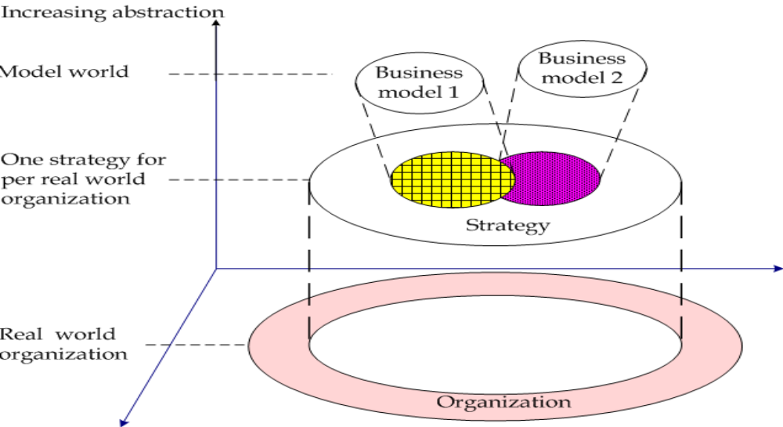
To realize business strategy organizations develop business models. Business model actually presents specified demands of business strategy, what is presented in figure –

Slide 98
Business model is treated as conceptual and architectural implemented business strategy or as base to execute differentiated organization business that presents its tacit potential to reach competitive advantages. It is an interface between a degree of development of information technology systems and a degree of creating economic value through e-business.

Slide 99
